Slide 1

Introduction to ASP.NET MVC and Web API
Joe Wilson,
Volare Systems, Inc.
volaresystems.com/blog
@joe_in_denver

Slide 2
Agenda
Where do MVC and Web API fit in today’s web?
Basics of MVC
Basics of Web API
What about testing?
Are MVC or Web API a fit for your project?

Slide 3
Basics of MVC
M = Model
V = View
C = Controller

Slide 4
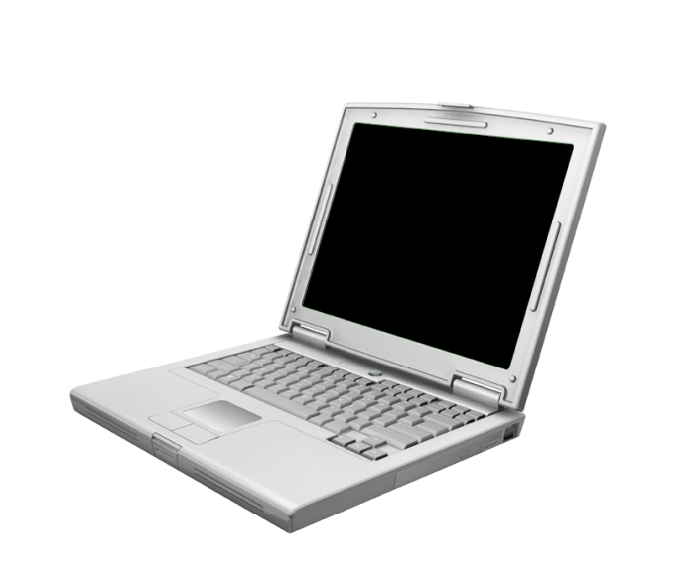

Basics of MVC - Routing
Controller
Action
http://server/product/edit
Request
Response
HTML, JSON, File, XML

Slide 5
Basics of MVC - Routing
Request (GET or POST)
Routing Engine
Controller (Action)
Response
View,
JSON, File,
XML
Model

Slide 6
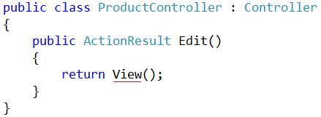
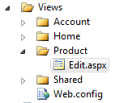
Basics of MVC - Routing
Controller
Action
http://server/product/edit
Folder
View

Slide 7
Basics of MVC – Views
Are .CSHTML files
Holds user interface elements (HTML, CSS, JavaScript)
Views should not contain much logic
Simple “if”s or “foreach”es are OK

Slide 8
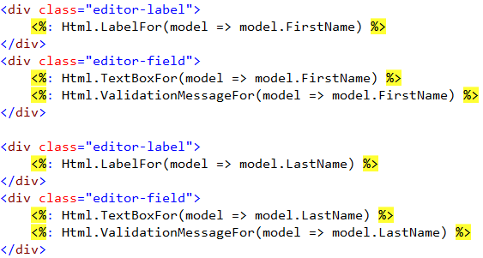

Basics of MVC – Views

Slide 9
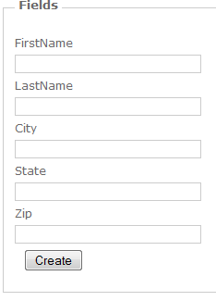
Basics of MVC – Views

Slide 10
Basics of MVC – Controllers
Are .CS files
Holds commands and workflows in Actions (methods)
Render Views, JSON, XML, RSS, File, etc.
Works with Models for small logic and data
Validate user input before moving on

Slide 11
Basics of MVC – Models
Are .CS files
Data to display in the View
Data posted from the View back to the Controller
Good place for validation attributes
Good place for light, display-related logic (Full Name, Totals, IsUserLoggedIn, etc.)

Slide 12
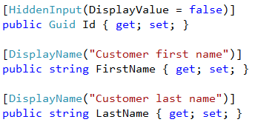
Basics of MVC – Validation

Slide 13
Basics of MVC - What else?
Part of ASP.NET
Can run side-by-side with Web Forms, Web API, SignalR, etc.
Cookies, Session, Caching, etc. still work the same
Extensible for changing Routing, View Engine, Model Binders, Action Filters, etc.

Slide 14
What problem is MVC trying to solve?
Problem: No Separation of Concerns guidance
Don’t just dump all your code in code behind files
MVC gives guidance about what kind of code goes where
Convention over configuration

Slide 15
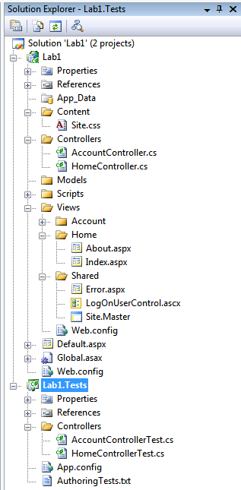
What problem is MVC trying to solve?
Style Sheets, Images
Controllers
Models
JavaScript
Views
Master Pages
Tests

Slide 16
What problem is MVC trying to solve?
Problem: Web code testability
Code behind files are hard to test
HttpContext is hard to mock
MVC provides mockable abstract classes (but mocking is still not as easy as it could be)

Slide 17
What are the benefits of MVC?
Benefit: Clean HTML
MVC controls keep their IDs
Easier to navigate with JavaScript and jQuery
Easier to build Section 508 compliant sites (use W3C Validators and Section508.info to check)

Slide 18
What are the benefits of MVC?
HTML from Web Forms
<span id="ctl00_MainContent_uxdPHAllContent_TripSelector_lblFromDate">
From Date:</span>
<input type="text" name="ctl00$MainContent$uxdPHAllContent$TripSelector$txtFromDate" id="ctl00_MainContent_uxdPHAllContent_TripSelector_txtFromDate" />
HTML from MVC
<label for="FromDate">From Date:</label>
<input type="text" name="FromDate" id="FromDate" />

Slide 19
What are the benefits of MVC?
Benefit: Clean URLs
MVC has more hackable, SEO-friendly URLs
URLs without query strings

Slide 20
What are the benefits of MVC?
URLs for ASP.NET Web Forms
http://mysite.com/Shop.aspx?Category=Shirts
http://mysite.com/Shop.aspx?ID=123
URLs for ASP.NET MVC
http://mysite.com/Shop/Category/Shirts
http://mysite.com/Shop/ID/123

Slide 21
What are the benefits of MVC?
Benefit: Headroom
Extensible for changing
Routing
View Engine
Model Binders
Action Filters
Controller Factories
All code is released as open source

Slide 22
Code!

Slide 23
Drawbacks of MVC
Do you need it?
So close to Web API it can trip you up (hopefully changing with ASP.NET vNext)

Slide 24
Drawbacks of Web API
Parameter binding and 404s can be annoying
So close to MVC it can trip you up (hopefully changing with ASP.NET vNext)

Slide 25
Resources
Microsoft site for MVC - asp.net/mvc
Microsoft site for Web API - asp.net/web-api
Pluralsight - pluralsight.com
volaresystems.com/blog
@joe_in_denver

